Slide 1



HCC Gaps
View in Power BI
Last data refresh:
9/5/2018 4:33:49 PM Eastern Standard Time
Downloaded at:
6/3/2019 12:12:46 PM Eastern Standard Time

Slide 2
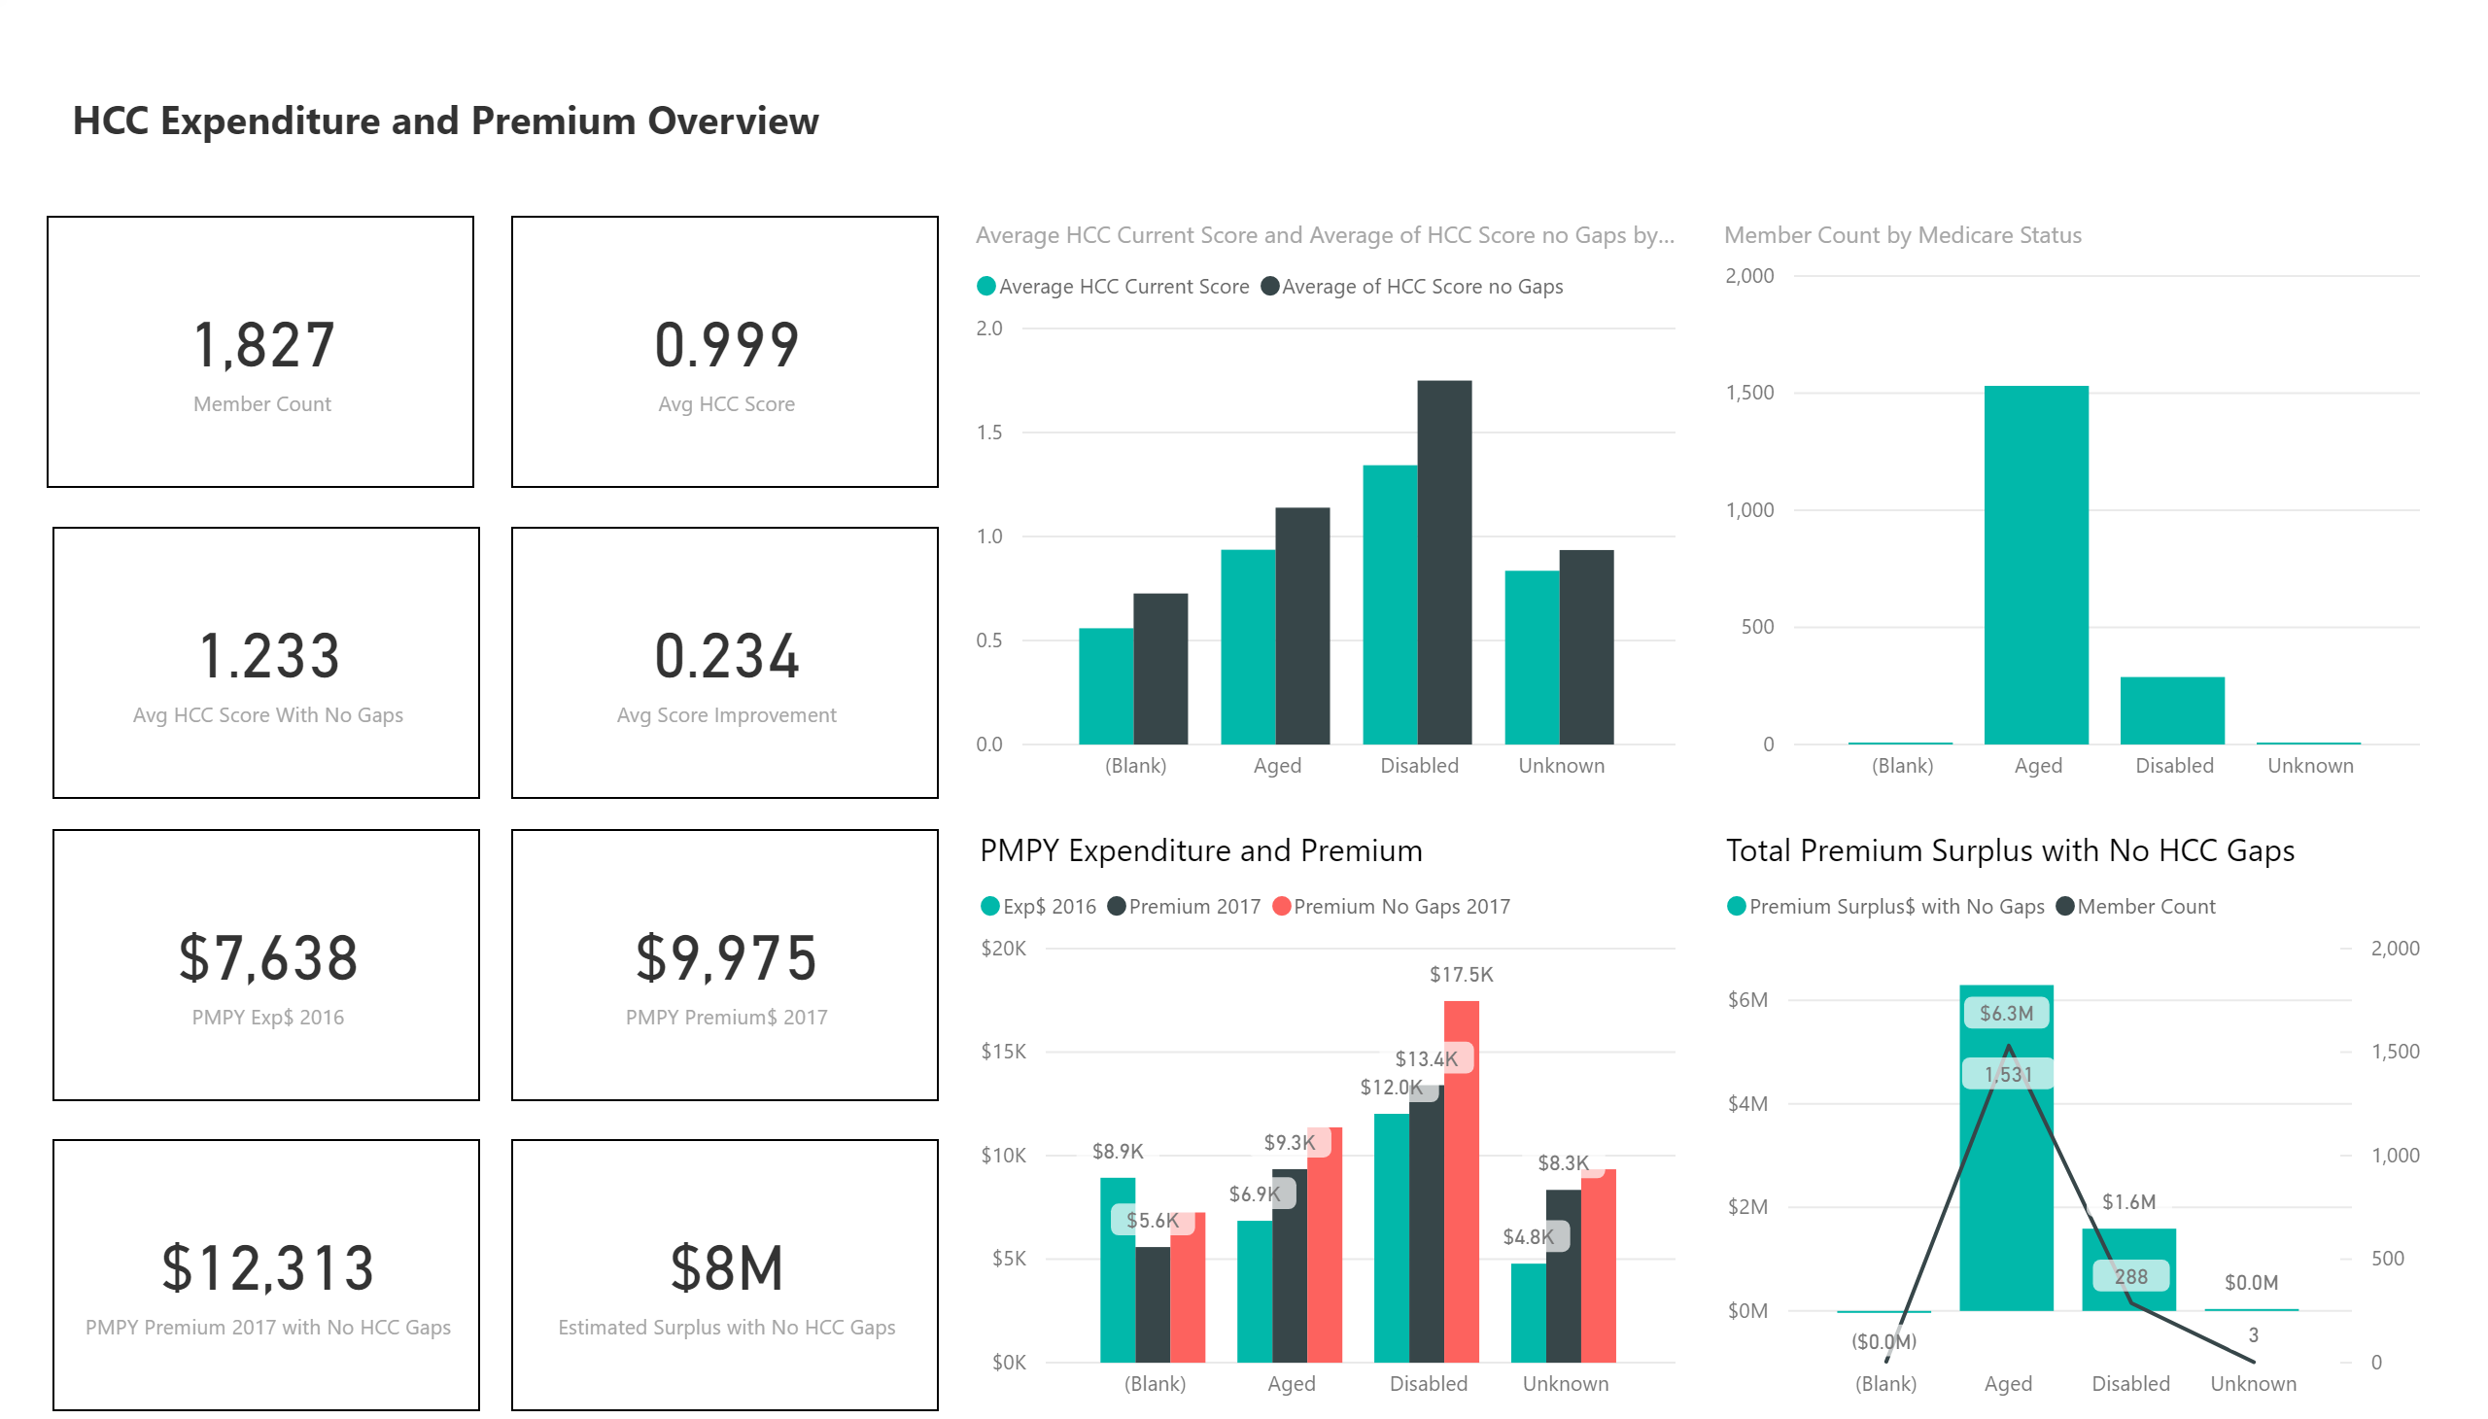

Slide 3
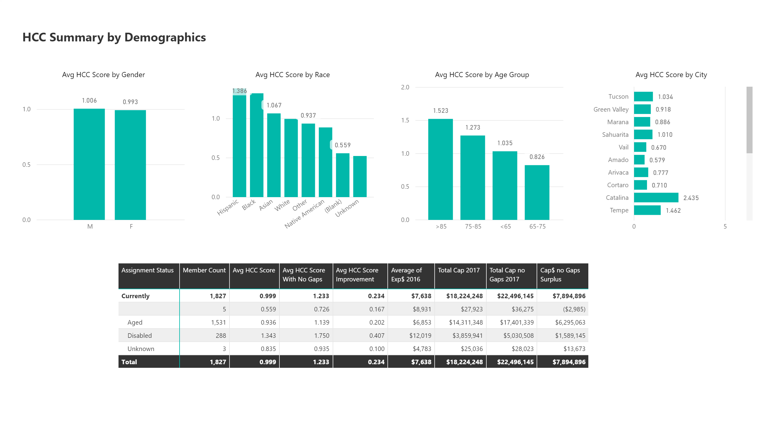

Slide 4
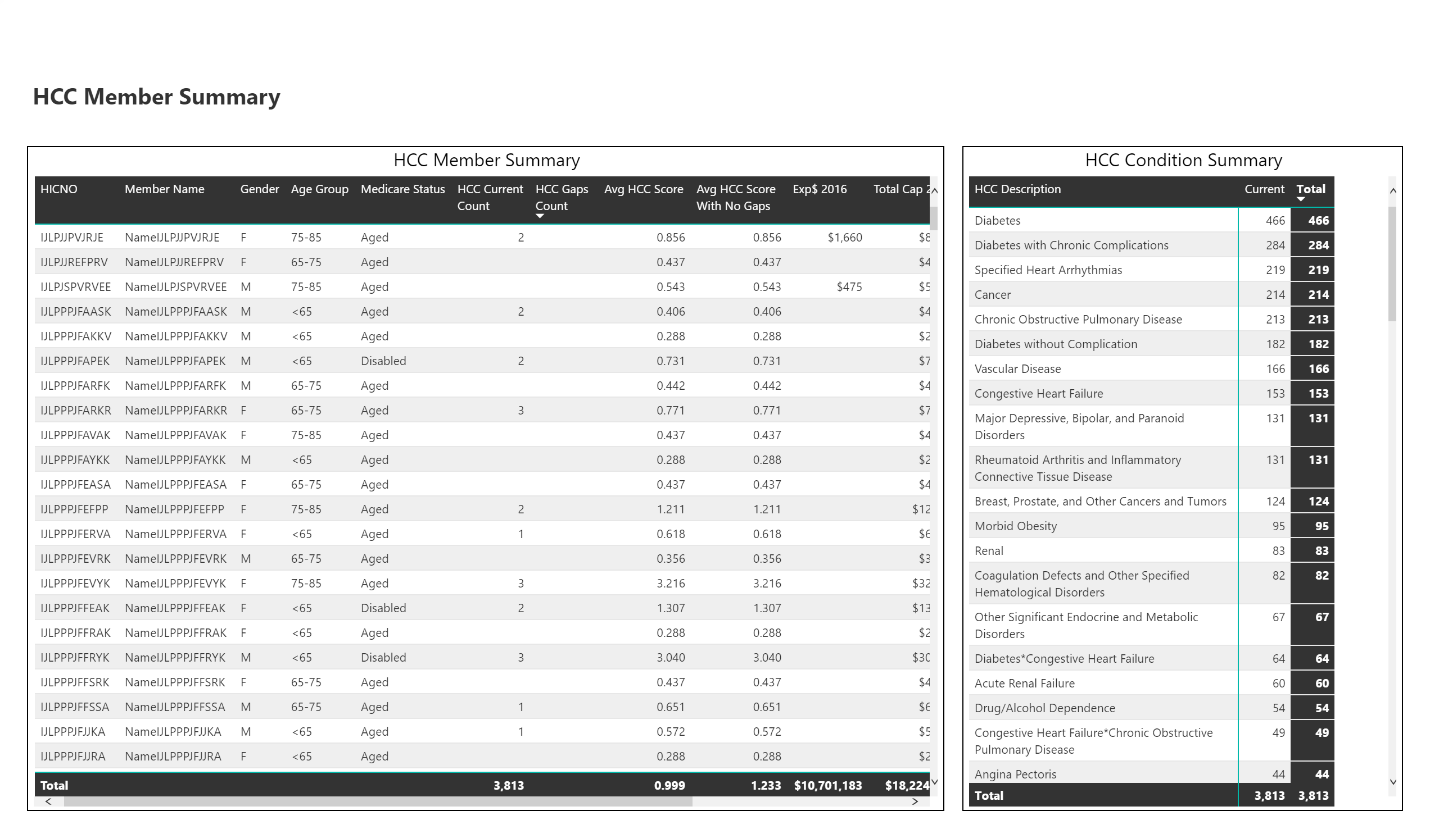

Slide 5
